Slide 1

Step by Step Study with Full Equations
Minidu Wickramaarachchi
Professor: 杨强 (Qiang Yang)
The School of Artificial Intelligence, Nanjing University of Information Science and Technology. Nanjing 210044, China.
Email：miniduwickramaarchchi97@gmail.com
2026-04-08

Slide 2
Core Idea and Notations
PSO is a population based metaheuristic that simulates how swarm (bird or fish) collectively search for optimal solutions. Each solution candidate is a “particle” that moves through search space.
NP
xᵢ
vᵢ
pbest_i
gbest
Total number of particles in the swarm
Current position (solution) of particle i
Current velocity (direction & speed) of particle i
Personal best position found so far by particle i
Global best position found by any particle so far
Each iteration: particles move, update their velocity based on personal & swarm memory, and converge toward optimal regions.

Slide 3
Standard Velocity Update Equation
vᵢ = ω.vᵢ + c₁.r₁(pbest_i − xᵢ) + c₂.r₂(gbest − xᵢ)
Inertia Term ω·vᵢ
Cognitive Term c₁r₁(pbest_i − xᵢ)
Social Term c₂r₂(gbest − xᵢ)
ω = inertia weight
Controls how much previous velocity is carried forward.
High ω → exploration (particle travels far)
Low ω → exploitation (particle focuses locally)
Typically: ω decreases over time from 0.9 → 0.4
c₁ = cognitive acceleration coeff.
r₁ = random ∈ [0, 1]
Pulls particle toward its own personal best.
(pbest_i − xᵢ) = displacement to personal best
Models individual memory / self-confidence.
Typically c₁ = 2.0
c₂ = social acceleration coeff.
r₂ = random ∈ [0, 1]
Pulls particle toward the global best position.
(gbest − xᵢ) = displacement to swarm best
Models social learning from the group.
Typically c₂ = 2.0

Slide 4
Position Update & pbest / gbest Rules
xᵢ = xᵢ + vᵢ
pbest_i is updated only if f(xᵢ_new) < f(pbest_i)
Personal Best (pbest) Update
Global Best (gbest) Update
if f(xᵢ) < f(pbest_i)
→ pbest_i = xᵢ
gbest = arg min f(pbest_i)
∀ i ∈ {1 … NP}
Each particle remembers the best position it has personally visited. After each move, compare the new fitness to the stored personal best and replace if better.
The global best is the best position found by ANY particle across the entire swarm. Updated by scanning all pbest values each iteration.

Slide 5
Modified PSO– Elite Archive (Top-M)
The notes introduce a key modification: instead of a single gbest, an archive of the top M particles is maintained each iteration.
Archive Size Formula:
M = ⌊ p × NP ⌋
p = archive fraction ∈ (0, 1)
NP = swarm size
M = number of elite particles kept
Elite Membership Condition:
particle i ∈ Archive iff f(xᵢ) ≥ f_worst(M)
f_worst(M) = fitness of the worst particle currently in the top-M archive
Top-M → Elite Archive (1st case)
Remaining (NP − M) → Normal Update (2nd case)

Slide 6
Two Case Position Update Rule
Each iteration, particles are split into two groups and updated differently:
1st Case — Elite Particles
2nd Case — Non-Elite Particles (NP − M)
Condition:
Condition:
f(xᵢ) ≥ f_worst(M)
f(xᵢ) < f_worst(M)
Action:
Action (φ-blended update):
xᵢ → NO UPDATE
vᵢ = ω·vᵢ + c₁r₁(pbest_i−xᵢ)
+ c₂r₂(Exp₂−xᵢ)
Particle is already in the elite archive. Its position is preserved — it does NOT update velocity or position this iteration. This protects good solutions from being overwritten.
These particles apply the standard velocity update with φ ∈ [0,1] controlling the blending. They are guided toward the archive (Exp₂) instead of a single gbest.

Slide 7
The φ Parameter and Guidance Terms
The notes annotate two different guidance sources (Exp₁ and Exp₂) circled in red/green, with the note 'better' pointing from Exp₁ to Exp₂. This means the algorithm tests different guidance strategies:
Exp₁ — Personal Best Direction
Exp₂ — Archive (Social) Direction ← 'better'
Uses the particle's own pbest_i as guidance.
Annotated in notes as the weaker guidance source.
Uses a randomly selected elite particle from the Top-M archive. Noted as the superior guidance source in the notes.
The φ Blending Parameter:
φ ∈ [0, 1] → tested: 0.1, 0.2, 0.3, … 0.9
φ controls how strongly the archive (Exp₂) guidance influences the velocity update for non-elite particles. A systematic grid search over φ = {0.1, 0.2, ..., 0.9} will determine the optimal blending ratio for CEC 2017 test functions.

Slide 8
Modification Plan and Implementation Plan
1
Initialize NP particles with random positions xᵢ ∈ search space, random velocities vᵢ
Phase 1: Standard PSO Baseline
Phase 2: Add Elite Archive (Top-M)
2
Evaluate fitness f(xᵢ) for all particles. Set pbest_i = xᵢ, gbest = best of all xᵢ
Code standard PSO: initialize NP particles, velocity update (ω, c₁, c₂, r₁, r₂), pbest & gbest tracking. Validate on simple benchmark (Sphere function).
Implement archive: sort particles by fitness, select top M = ⌊p×NP⌋. Code two-case update logic. Test the condition f(xᵢ) ≥ f_worst(M).
3
Build Archive: rank all particles by f(xᵢ). Select top M = ⌊p × NP⌋ → elite archive
4
For each particle i: if f(xᵢ) ≥ f_worst(M) → 1st Case: skip update (preserve elite)
Phase 3: φ Parameter Integration & Tuning
Phase 4: CEC 2017 Full Evaluation
5
Otherwise → 2nd Case: update vᵢ using ω, c₁, r₁, c₂, r₂, φ with Exp₂ from archive
Add φ ∈ [0,1] to 2nd Case update. Run grid search: φ = 0.1, 0.2 ... 0.9. Compare convergence speed and final fitness across φ values.
Integrate all 29 CEC 2017 test functions. Run Standard PSO vs Modified PSO comparison. Record mean, std, convergence curves. Final report.
6
Update position: xᵢ = xᵢ + vᵢ. Update pbest_i if f(xᵢ_new) < f(pbest_i)
7
Repeat steps 3 - 6 for T iterations. Record best solution found.

Slide 9
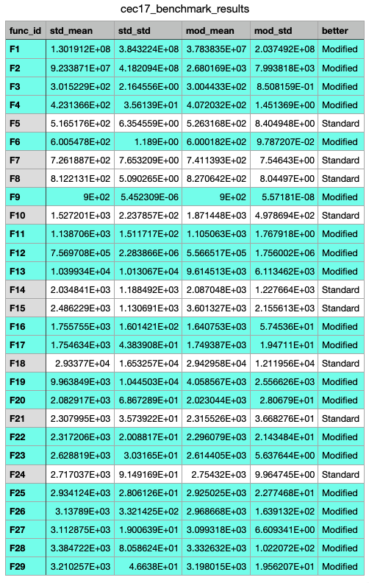
Results as for the implementation
Modified PSO wins 20 out of 29 functions. The standout is F2, where Modified PSO is roughly better than Standard. On most of the composition functions (F21–F29) and hybrid functions (F11–F20), the Modified PSO consistently produces lower mean fitness and crucially a much lower std (standard deviation), meaning it's more stable and repeatable.
The concerning cases, 9 functions where Standard wins:
What this means:
The elite archive is clearly helping on most functions but hurting on highly multimodal problems like Rastrigin based ones (F5, F7, F8).
What to check withis is that the next thing to investigate would be whether adjusting p (archive fraction) helps on those failing functions which is a smaller archive (less freezing) might recover performance on F5/F7/F8/F15.
Function | Problem | What's happening
F5, F7, F8 | Rastrigin variants | Multimodal because elite archive may be locking onto local optima too early
F10 | Schwefel | Very deceptive as Modified 22% worse
F15 | Hybrid 5 | Biggest loss as the Modified 45% worse, high std too
F14, F18, F21, F24 | Hybrid/Composition | Marginal losses

